Slide 1


Critical Zone Exploration Network (CZEN) Research Site Exploration
Johnathan Clementi

Slide 2
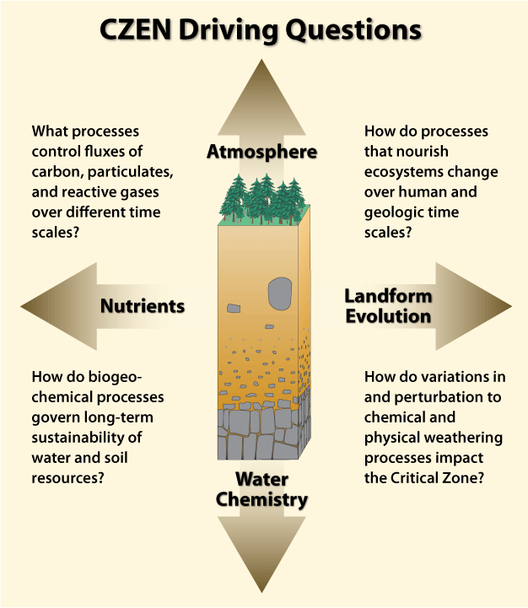
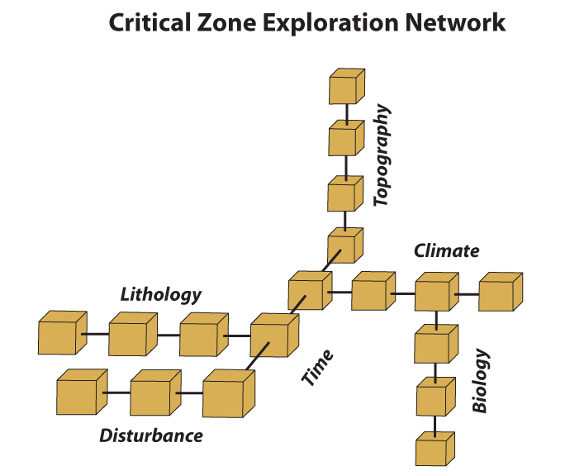
Introduction
Context:
CZEN is a collection of field research sites that investigate the ‘Critical Zone’

Slide 3
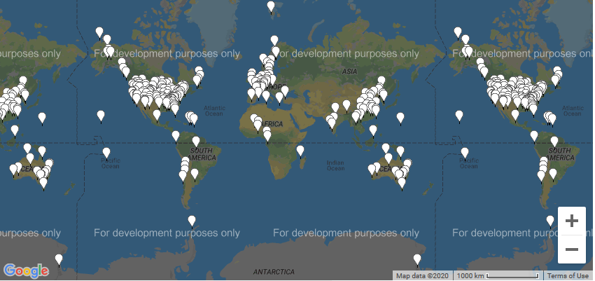
Introduction
CZEN Site Seeker – tool designed to promote collaboration

Slide 4
Data model
List of Variables:
1. Field Site - (Categorical) - Name given to field site
2. Latitude - (Quantitative) - Latitude of field site
3. Longitude - (Quantitative) - Longitude of field site
4. Field Site type - (Categorical) - Affiliation of field site with US or international based research groups
5. Registration - (Categorical) -Is the field site a registered member of CZEN
6. Mean Annual Precipitation - (Quantitative) - Average precipitation in millimiters per year
7. Average Annual Temperature - (Quantitative) - Average temperature in degrees Centigrade
8. Geology - (Categorical) - Most common geology type present at field site
9. Land Cover - (Categorical) - Most common land cover type present at field site
10. Climate - (Categorical) - Most common climate type present at field site
11. Sub-Climate - (Categorical) - Second most common climate type present at field site
12. Network(s) - (Categorical) - Research networks the field site is affiliated with
13. Soil Order - (Categorical) - Most common soil type present at field site
14. Study Start Date - (Quantitative) - The year in which the field site was opened for research
15. Hydrology: Surface water stream order - (Categorical) - Stream order of primary surface water present at field site
16. Hydrology: Surface water - Stream Flow Performance - (Categorical) - Stream flow type of primary surface water present at field site
17. Hydrology: Groundwater - (Categorical) - Type of groundwater present at field site

Slide 5
Project Order of Operations
Data Cleaning
Data Cleaning
Identify and fix primary errors using automation.
Primary Visualization
Create figures for variables and identify secondary errors with data.
Primary Visualization
Revisit Data Cleaning
Revisit Data Cleaning
Fix data errors identified in ‘Primary Visualization’ step.
Secondary Viz & Results
Create additional figures and communicate findings to outside world.
Secondary Visualization & Results Communication

Slide 6
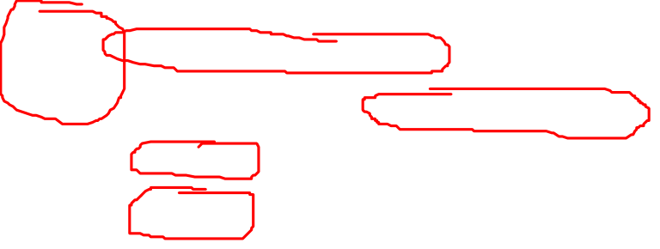
Pre-cleaning Data
Primary issues:
Units
Misspellings
Secondary Issues
Outliers that didn’t make sense (73C)
Complex entries (Groundwater)
Multi-value entries

Slide 7
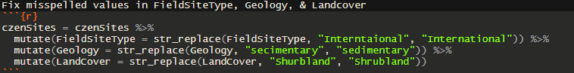
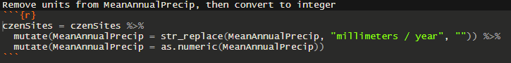
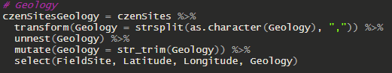
Data Cleaning
Came across multiple misspellings in the data
Removing Units from integer variables
In order to process multi-value variables, I broke each one into its own data frame

Slide 8
Research Questions
1
Which geographic locations are represented well by research sites? Which geographic locations are poorly represented by research sites?
2
Which climate regimes are (not) well represented?
3
What other environmental variables are (not) well represented?

Slide 9
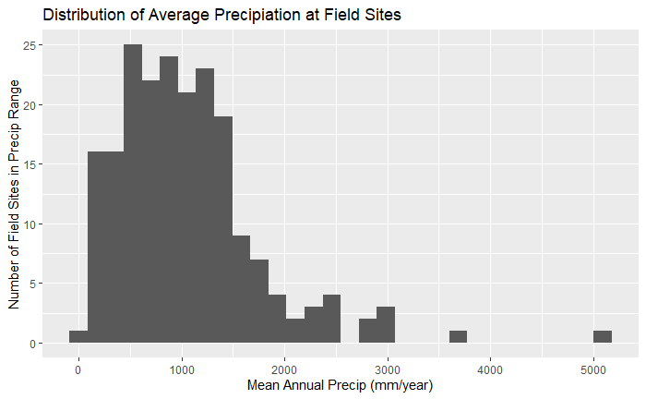

Slide 10
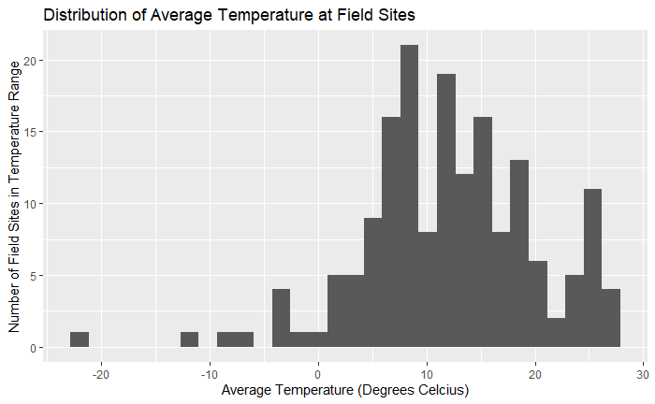

Slide 11
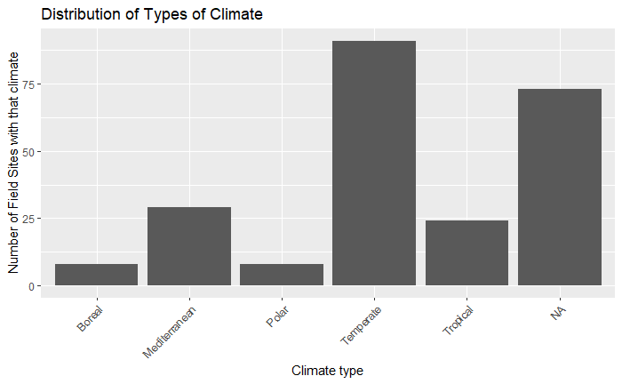


Slide 12
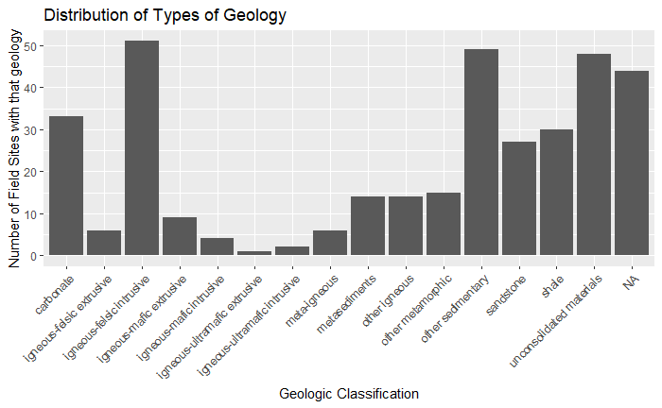


Slide 13
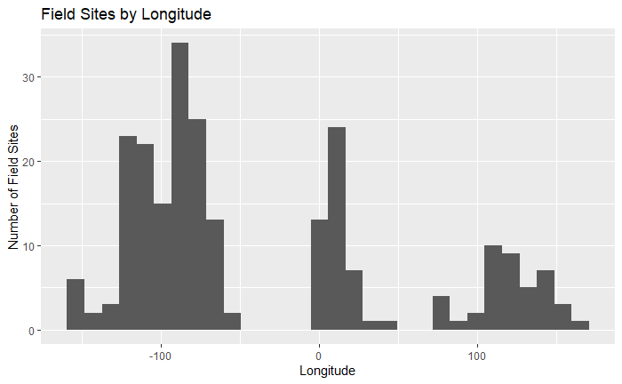


Slide 14
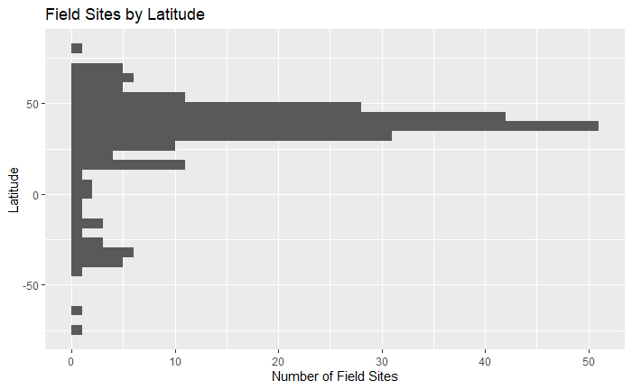

Slide 15


Slide 16
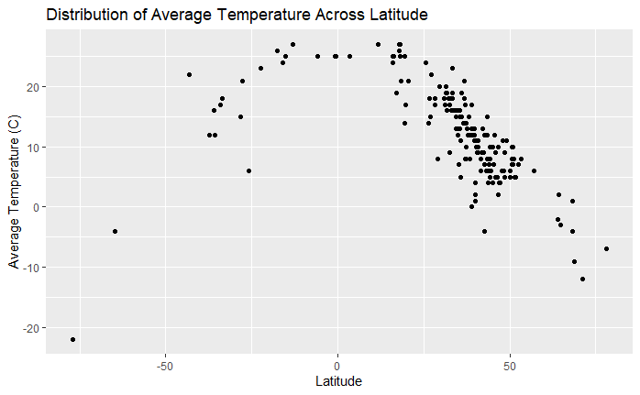

Slide 17
Key Takeaways
US, Europe, and China are leaders of long-term ecologic / Earth system research
Temperate climates are most studied climates
Many research sites do not have climate or geology data collected

